Slide 1
SUPERSTORE SALES DASHBOARD PROJECT
Insights into Sales, Profit, and Regional Performance
Created by – Shivani Nirmal

Slide 2
OVERVIEW
Objective:
Tools Used:
Dataset:
Scope:
To provide a comprehensive overview of sales performance across categories, regions, and time.
Excel & Power BI
Superstore sales data including Orders, Customers, Products, and Shipping.
Tracks KPIs such as Sales, Profit, Quantity, and across multiple dimensions.

Slide 3


The dashboard provides an interactive view of sales and profitability trends across regions and customer segments.

Slide 4
KEY INSIGHTS FROM THE DASHBOARD
Top Region: Western Region contributed the highest sales.
Profitable Segment: Home Office yields the highest profit margin.
Sales Trend: Peak sales occur in November 2017
Category Performance: Technology has consistent growth, while Furniture needs focus.

Slide 5
HOW INTERACTIVITY ENHANCES DECISION-MAKING
Slicers used for filtering by Month Year
Visuals respond dynamically to selections.
Drill-through available to view sub category or customer-level detail.
Tooltips provide quick insight without leaving the page like Profit Margin.

Slide 6
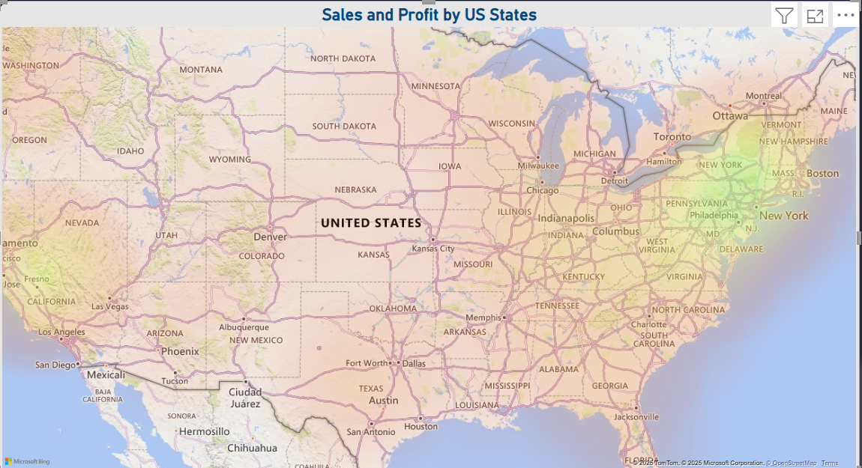
TOOLS AND FEATURES USED IN THE DASHBOARD
Power BI Features
External Tools
DAX Measures used to calculate Profit Margin.
Used Map visuals for Regional Analysis.
Data cleaned using Excel.
Source: Sample Superstore Dataset

Slide 7
STRATEGIC RECOMMENDATIONS
Boost Furniture Profitability
Optimize Shipping Costs
Leverage the West region’s strengths.
Invest in Technology

Slide 8
Thank you!!

